Slide 1
Switch Case

Slide 2
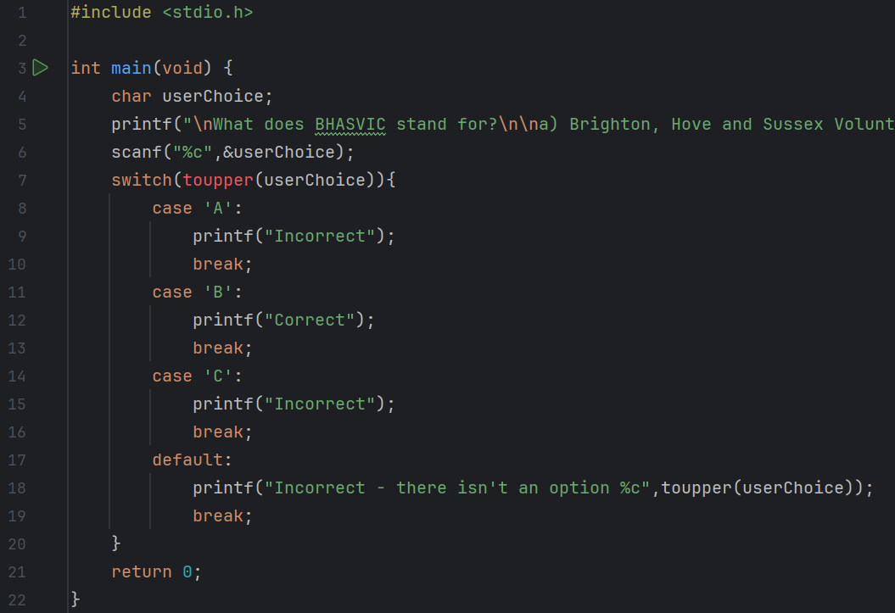
Predict
What do you think this code does?
It asks the user what BHASVIC stands for and asks them to input weather option a, b or c is correct. If they get it right it says it is correct, otherwise, it prints incorrect. If they entered something which is not A,B or C, they are told that their input is not an option.

Slide 3
Run
Download the code from Github and run it!
What does the code do?
It asks the user what BHASVIC stands for and asks them to input weather option a, b or c is correct. If they get it right it says it is correct, otherwise, it prints incorrect. If they entered something which is not A,B or C, they are told that their input is not an option.
Does this match your prediction?
Yes.

Slide 4
Investigate
Investigation Activities
What is the name of the variable being used?userChoice What data type does it hold? Chracter, a single letter or keystroke Add comments to lines 4-19 to explain what each line of code does. On next slide What does toupper() do? What is the opposite? Converts a character to an upper case value. The opposite is tolower() Remove lines 9 and 10, what happens? Why? It outputs “correct” to both A and B because there is no code if case ‘A’ is true so switches no next case, ‘B’. If C is entered it prints it is incorrect and for all other inputs outputs that there is no such option

Slide 5
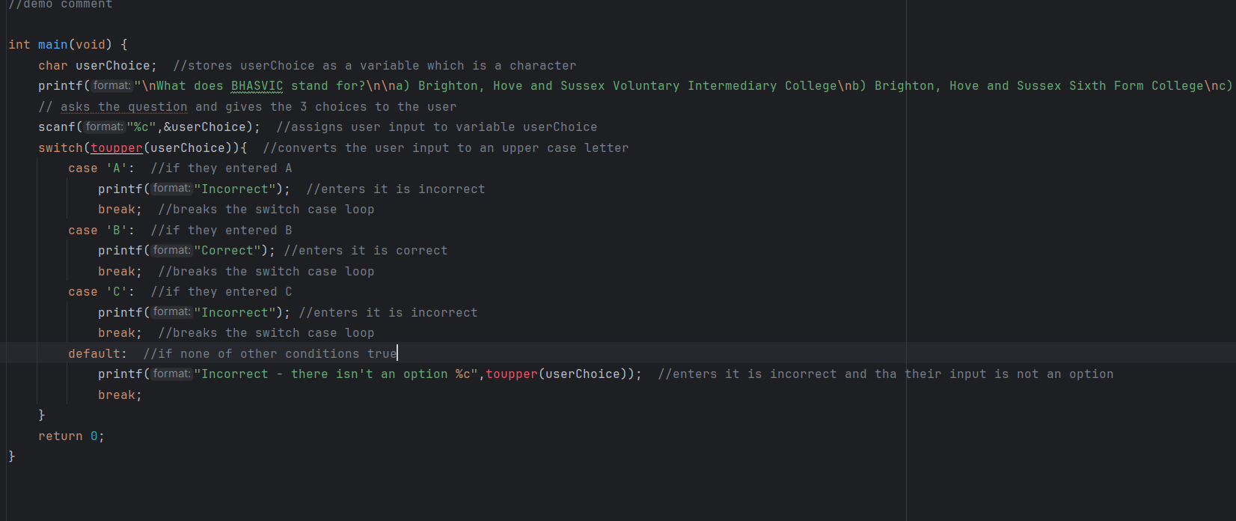

Slide 6
Modify
Modification Activities
Change the question and the messages displayed for each option. Add another possible answer. Add another question – use selection (if or switch statements) within the switch ???

Slide 7
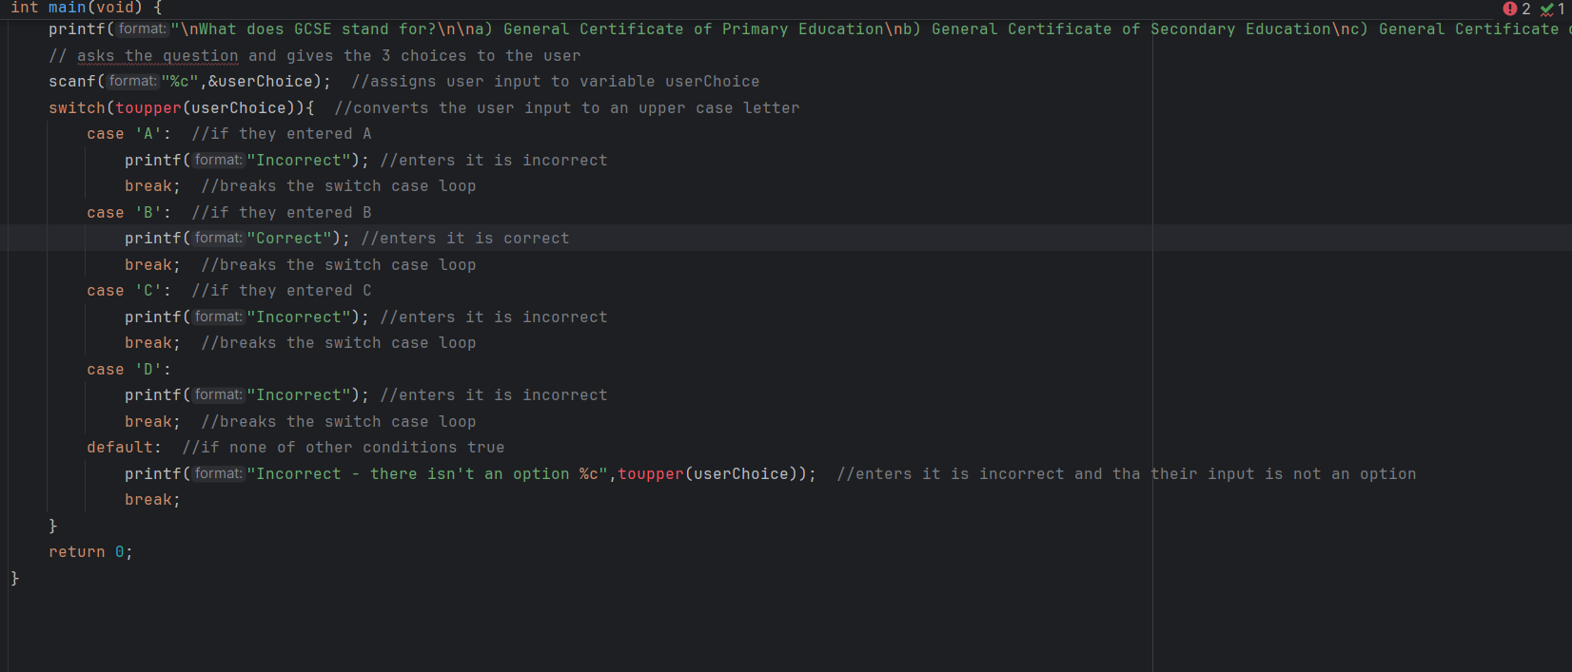
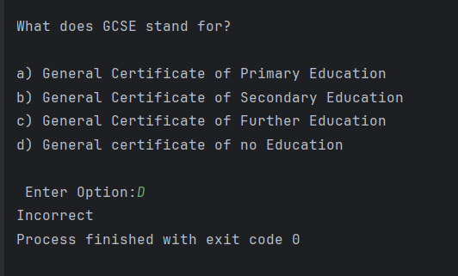

Slide 8
Make
Make Activities
Write a program that displays an on screen menu to the user. (You can use the escape code \t to create nice spaced out tabs/ columns). The user should be given a choice of four numbers Use a case statement to determine which message is displayed For each choice your program should display a different message, including one for if they have not made a valid choice

Slide 9
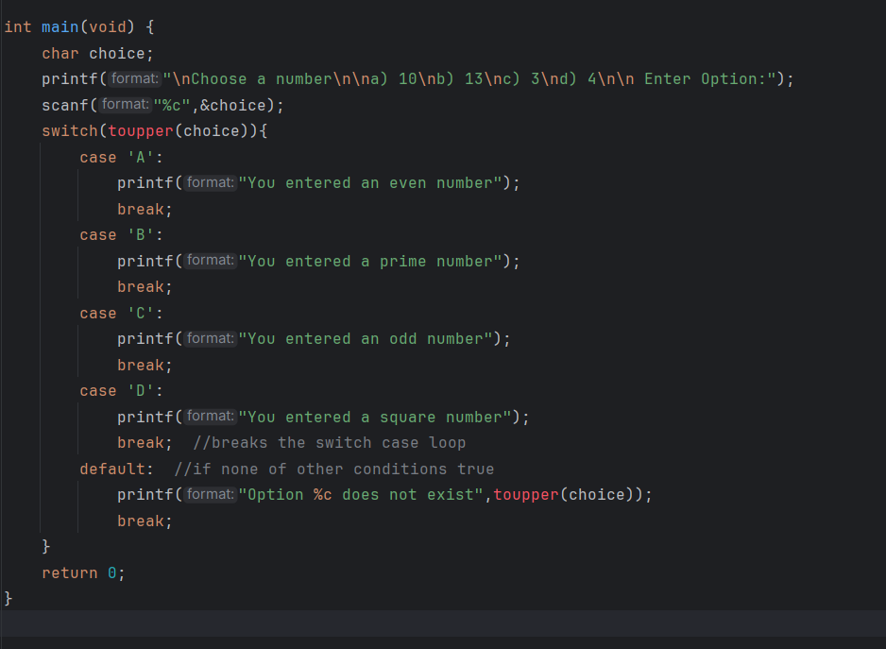
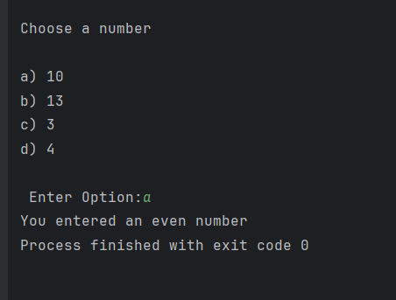

Slide 10
Make
Make Activities
Write a program that uses a CASE structure to act as a simple calculator. Requirements: Ask the user for two integers and store these two numbers in variables Get the input from a choice of add, subtract, multiply or divide (+, -, *, / ) Use SWITCH CASE statements to do the different calculations and output both the sum and the result to the user e.g. 15 / 3 = 5 Can you add validation in to ensure that data entered is numbers only?

Slide 11
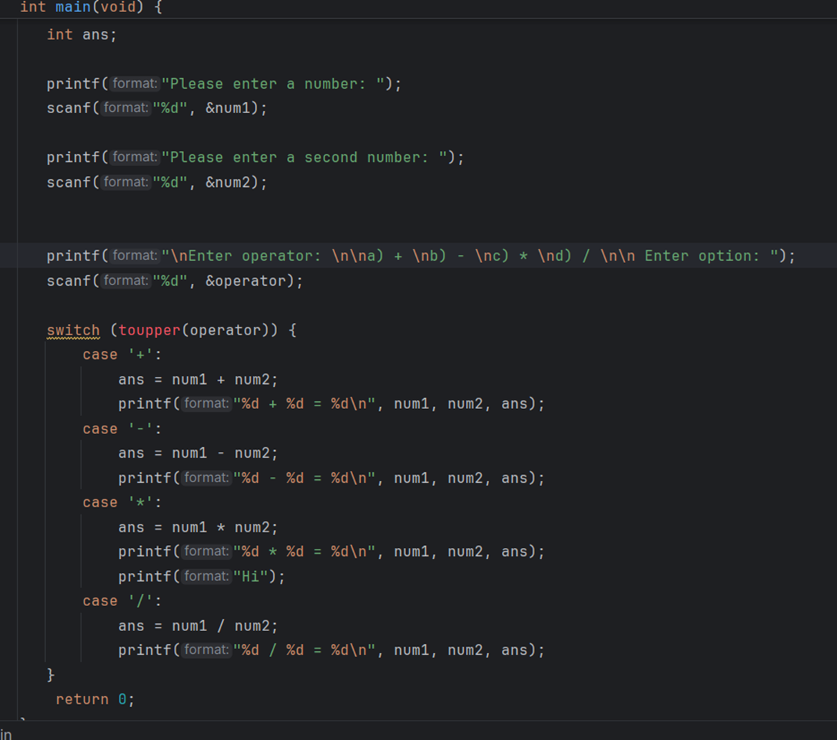
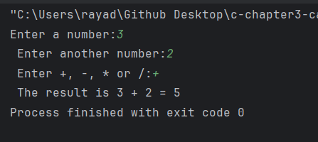
Not completed, validate

Slide 12
Make
Make Activities
Write a program to check a n alphabet character it is vowel or consonant using a SWITCH CASE. Requirements: Ask the user for a single character input Convert the input into an upper-case character (so that whatever they type it’s in that format) Use an efficient set of CASE statements to then output a suitable message telling the user ‘Vowel’ or ‘Consonant’

Slide 13
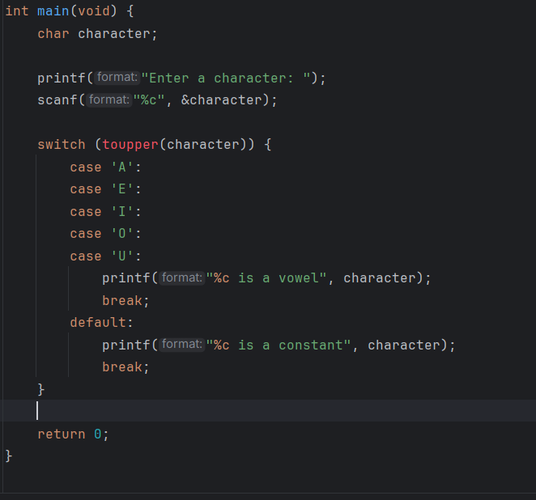
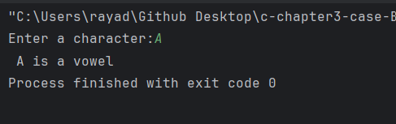

Slide 14
Make
Make Activities
Write a program using SWITCH CASE to check whether a number is even or odd. Requirements: Ask the user for an integer input Use the MOD operator (%) to work this out! Use SWITCH CASE statements to output either an ‘Odd’ or ‘Even’ message

Slide 15
